Slide 1
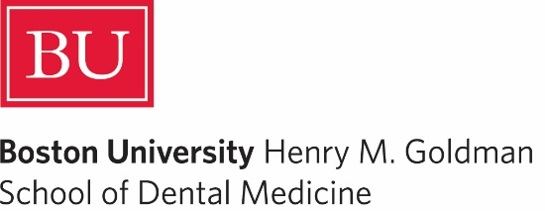

Research Study Design IV
DEPH 312 Principles of Scientific Evidence
Talal Alshihayb ^{BDS, DScD}
Diplomate, American Board of Dental Public Health
Assistant Professor
Department of Preventive Dental Science, College of Dentistry, King Saud bin Abdulaziz University for Health Sciences
Department of Health Policy and Health Services Research, Henry M. Goldman School of Dental Medicine, Boston University
December 14, 2023
shihaybt@ksau-hs.edu.sa

Slide 2
Recap
Study tasks
Descriptive
Predictive
Causal
Descriptive epidemiology
Measures of disease occurrence
Causal epidemiology
Measures of association
Study designs

Slide 3
The goal is to correctly estimate
For descriptive task
Measure of disease occurrence:
Prevalence
Incidence
For a predictive task
Mean squared error
Root mean squared error
Sensitivity
Specificity
Predictive value (positive or negative)
Area under the curve (ROC)
For a causal task
Measures of disease association:
Difference scale (risk difference, rate difference, time difference, etc.)
Ratio scale (risk ratio, rate ratio, odds ratio, time ratio, etc.)

Slide 4
Study designs
Descriptive task
Causal task
Case reports
Cohort
(longitudinal)
Observational
Interventional/experimental
Case series
Cross-sectional
Case-crossover
Cross-sectional
Randomized clinical trials
Ecological
Cohort
(longitudinal)
Case-control

Slide 5

LECTURE LEARNING OUTCOMES OF EACH OF THE DIDACTIC SESSIONS
REFERENCE:
Chapter 7 in Rothman KJ. Epidemiology: an introduction. Oxford university press; 2012 May 4
Section 1.9 of Chapter 1 in Oral Epidemiology A Textbook On Oral Health Condition, Research Topics and Methods
LECTURE LEARNING OUTCOMES:
Describe the validity and precision in research.
Describe the role of random and systematic errors in research.

Slide 6
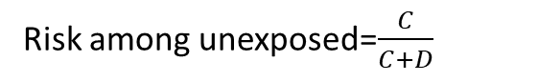
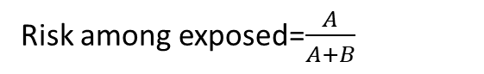
Risk difference (RD) A measure of association
 | Diseased | Non-diseased | Total
Exposed | A | B | A+B
Unexposed | C | D | C+D
Total | A+C | B+D | A+B+C+D
Risk among exposed=$\frac{A}{A+B}$
Risk among unexposed=$\frac{C}{C+D}$
Risk difference=risk among exposed-risk among unexposed= $\frac{A}{A+B} −\frac{C}{C+D}$
Risk difference=0 means no association

Slide 7

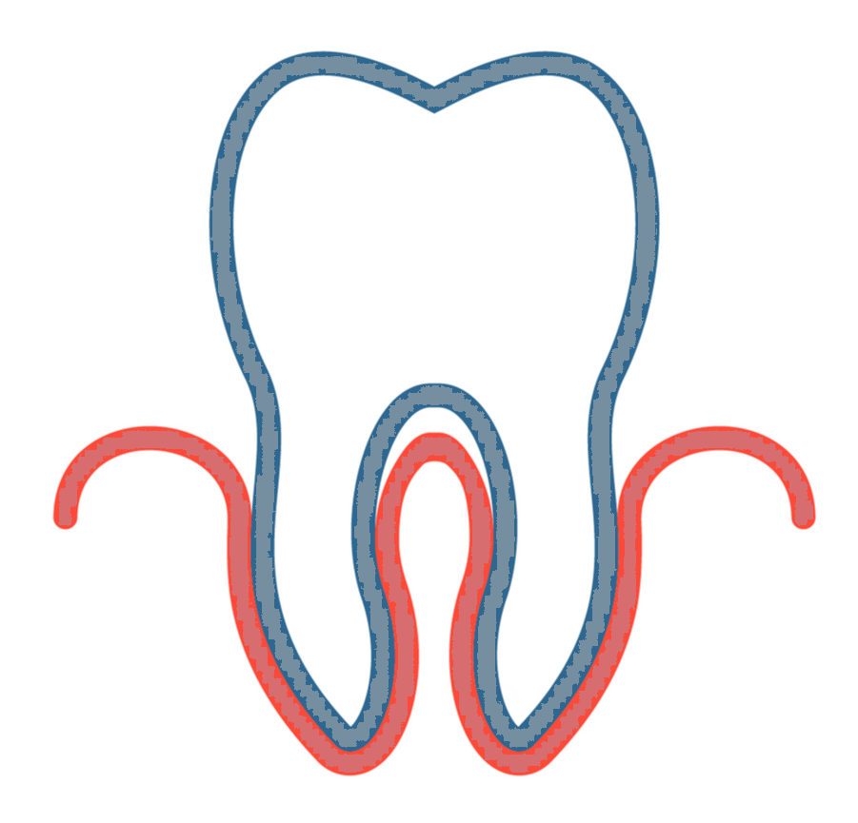


Exposure/independent variable
Outcome/dependent variable
 | Oral cancer | No oral cancer | Total
Periodontitis | 200 | 200 | 400
No periodontitis | 20 | 80 | 100
Total | 120 | 380 | 500
Risk of oral cancer among periodontitis=$\frac{200}{400}=0.5$
Is there an association between periodontitis and oral cancer?
Risk of oral cancer among no periodontitis=$\frac{20}{100}=0.2$
Yes
Risk difference=0.5-0.2=0.3

Slide 8

Risk difference=0.3
What are the reasons for this association between periodontitis and oral cancer in our study?
1
Random error
2
Sharing a common cause (confounding)
3
Conditioning on a common effect (selection bias)
Systematic errors
4
Measurement error (measurement bias)
5
Oral cancer caused periodontitis (reverse causation)
6
True (causal)

Slide 9
Errors in research
1
Random (precision)
Affects measures of dispersion (variance/standard deviation/range)
May affect point estimates (prevalence/incidence/effect size e.g., risk difference)
Systematic (validity)
Affects point estimates (prevalence/incidence/effect size e.g., risk difference)
What do we mean by this?
Difference between true causal effect and associational effect estimated from data
Structural reasons
2

Slide 10
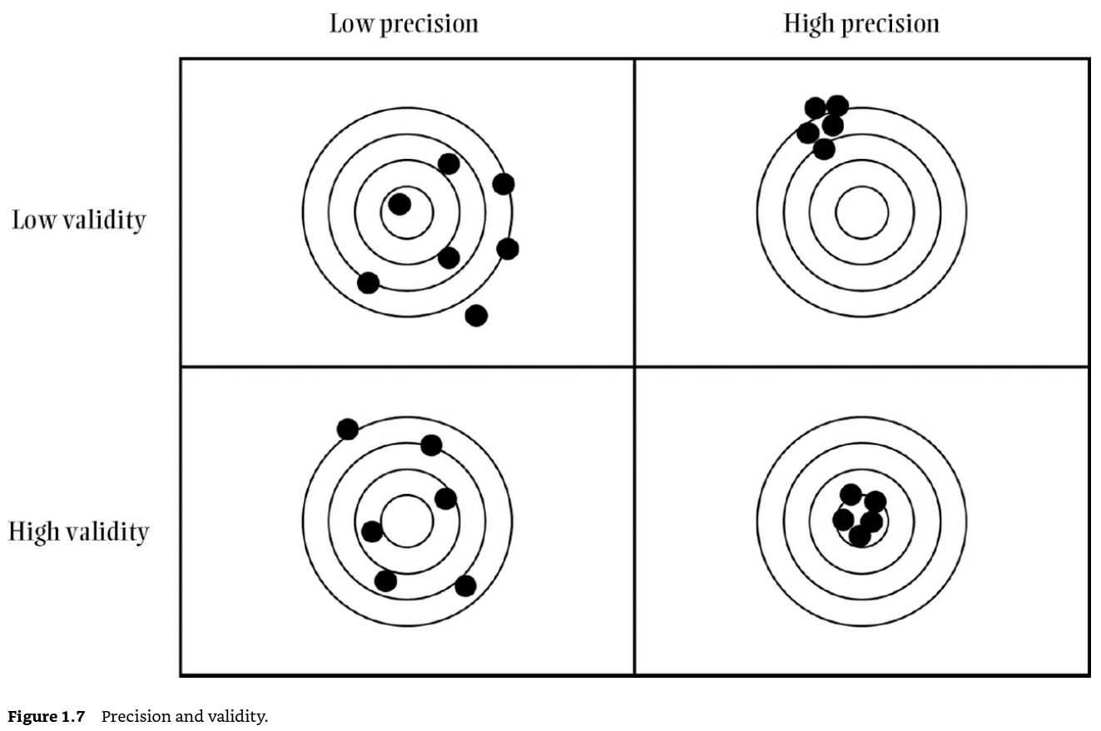
Westreich D. Epidemiology by design: a causal approach to the health sciences. Oxford University Press; 2019 Oct 16.

Slide 11
Types of systematic errors
Depends on study task (epidemiological paradigm)
Descriptive
Predictive
Causal
Hernán MA, Hsu J, Healy B. A second chance to get causal inference right: a classification of data science tasks. Chance. 2019 Jan 2;32(1):42-9.

Slide 12
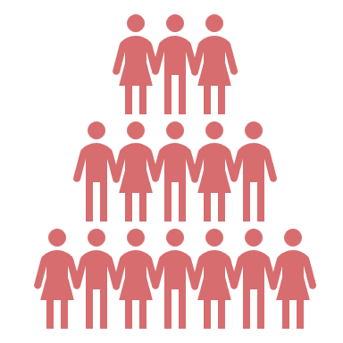

Random error
100,000
Risk difference=0
We want to conduct a study to know the effect of periodontitis on oral cancer
We cannot collect data on all 100,000 so we take a sample of 50 individuals in our study
Calculate the risk difference
Risk difference in our study was 0.15
True risk difference of 0.00
Error=0.15
Risk difference in 2nd study was 0.10
True risk difference of 0.00
Error=0.10

Slide 13

100 times
Risk difference is exactly 0.00 in study | Sample size in each study
RD is exactly 0 | 50 | 100 | 500 | 1,000 | 5,000 | 10,000 | 20,000 | 50,000 | 100,000
Yes | 2 | 5 | 16 | 17 | 43 | 57 | 79 | 96 | 100
No | 98 | 95 | 84 | 83 | 57 | 43 | 21 | 4 | 0
Min, max | -0.18, 0.16 | -0.15, 0.18 | -0.09, 0.06 | -0.05, 0.06 | -0.03, 0.02 | -0.01, 0.02 | -0.01,0.017 | 0.006, 0.01 | 0, 0
Range of error across 100 studies | 0.34 | 0.33 | 0.15 | 0.11 | 0.05 | 0.03 | 0.02 | 0.01 | 0

Slide 14
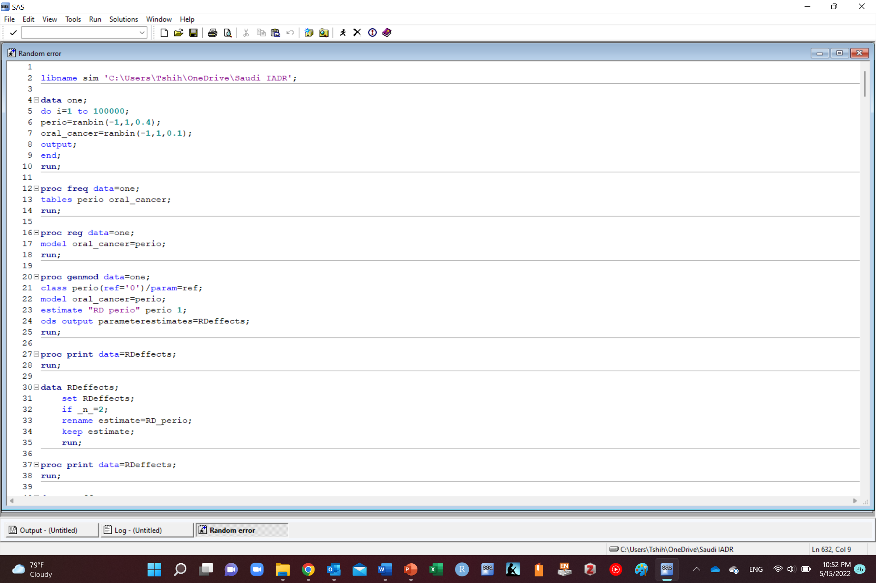

Slide 15
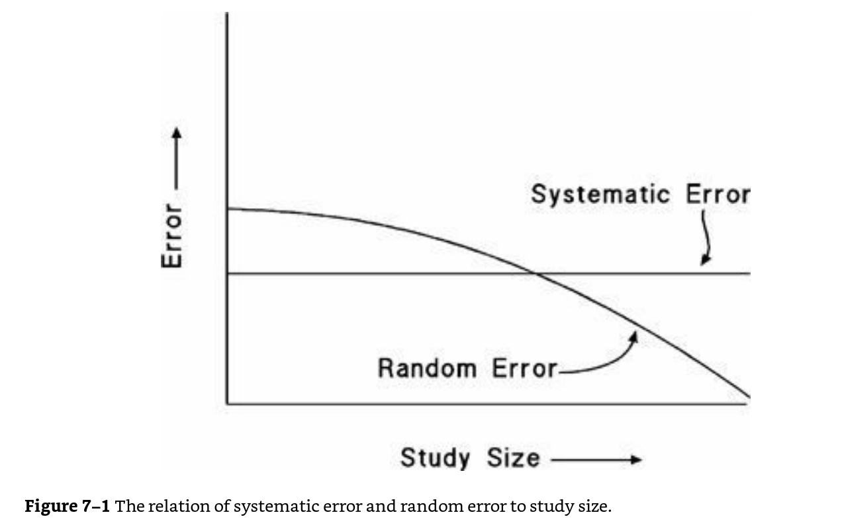
Rothman KJ. Epidemiology: an introduction. Oxford university press; 2012 May 4.

Slide 16
Risk difference=0.3
What are the reasons for this association between periodontitis and oral cancer in our study?
1
Random error
2
Sharing a common cause (confounding)
3
Conditioning on a common effect (selection bias)
Systematic errors
4
Measurement error (measurement bias)
5
Oral cancer caused periodontitis (reverse causation)
6
True (causal)

Slide 17
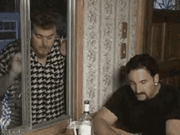
Systematic errors
Confounding bias
Selection bias
Measurement bias/information bias (misclassification bias)
Missing data
https://www.google.com/url?sa=i&url=https%3A%2F%2Ftenor.com%2Fsearch%2Fignore-gifs&psig=AOvVaw3Yc8-NyRhmOkRj1iJJFVS6&ust=1638540250309000&source=images&cd=vfe&ved=0CAwQjhxqFwoTCPClz6OkxfQCFQAAAAAdAAAAABAW

Slide 18
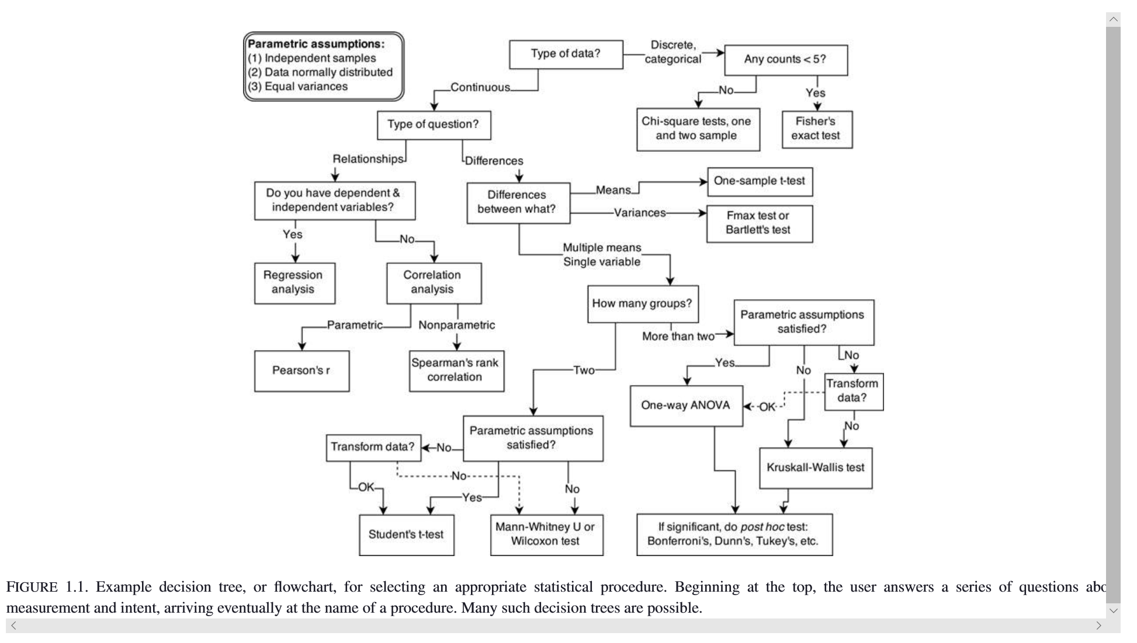
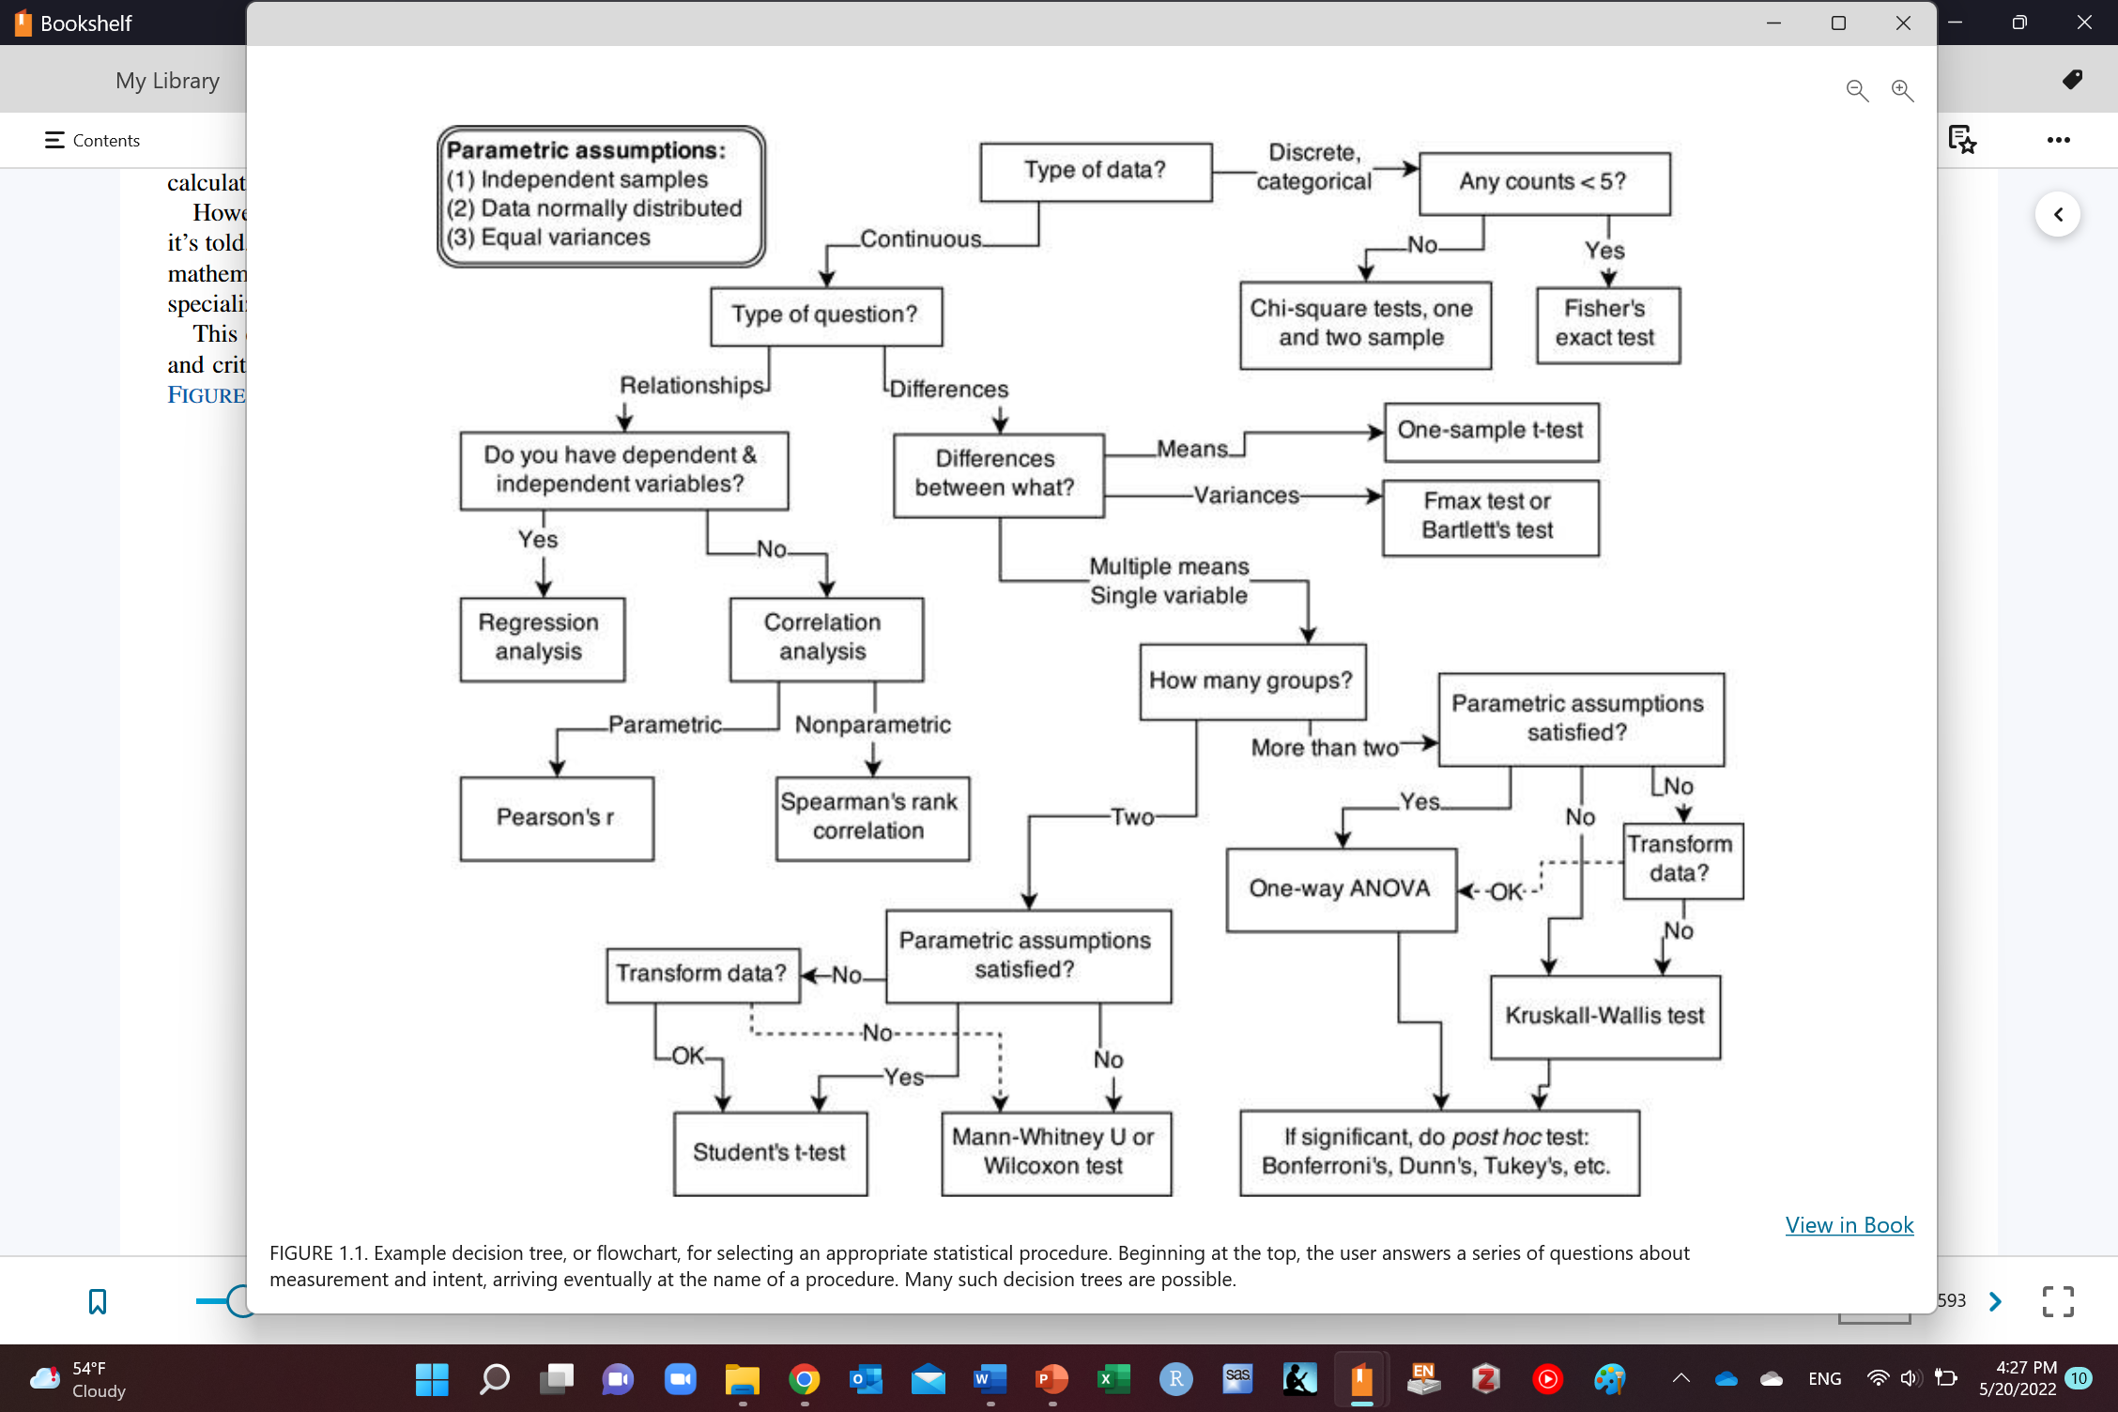
Statistical tests
Only acceptable in RCT with:
Individual randomization (no cluster/stratified/conditional)
Parallel groups (no cross-over/factorial design)
Perfect measurement (no measurement error)
No competing events for outcome
Balanced prognostic baseline factors (debatable)
To estimate a valid intention-to-treat effect:
Perfect follow-up (or loss to follow-up is completely at random)
Perfect adherence (or almost perfect) to approximate effect of treatment
To estimate a valid per protocol effect (naïve per-protocol):
Perfect follow-up (or loss to follow-up is completely at random)
Adherence is completely at random
Even if all above assumptions are met, using these flowcharts does not focus on the causal effect of interest (causal contrast of interest)
McElreath R. Statistical rethinking: A Bayesian course with examples in R and Stan. CRC press; 2020 Mar 13
Murray EJ, Swanson SA, Hernán MA. Guidelines for estimating causal effects in pragmatic randomized trials. arXiv preprint arXiv:1911.06030. 2019 Nov 14..

Slide 19
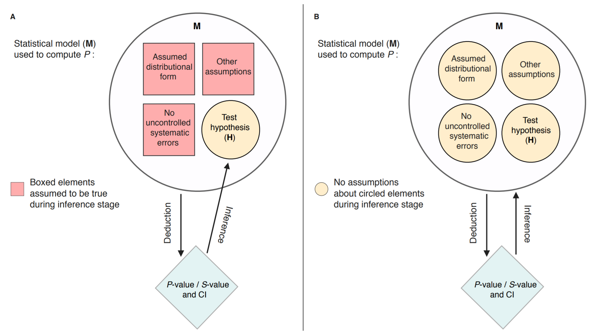
Greenland S, Chow ZR. To aid statistical inference, emphasize unconditional descriptions of statistics. arXiv preprint arXiv:1909.08583. 2019 Sep 18.

Slide 20
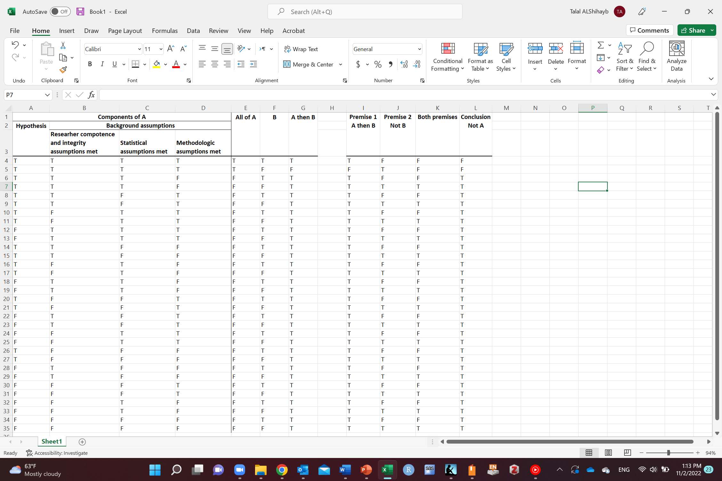

Slide 21

https://www.google.com/url?sa=i&url=https%3A%2F%2Ftenor.com%2Fsearch%2Fsecurity-guard-gifs&psig=AOvVaw1LI63XCu4PRBSZ9Vj-pJDg&ust=1609511777512000&source=images&cd=vfe&ved=0CAMQjB1qFwoTCJjb7OS4-O0CFQAAAAAdAAAAABAS

Slide 22
Why care about systematic errors in causal research?
Affect:
Results
Conclusions
Literature
Policies
Clinical practice
Guidelines

Slide 23
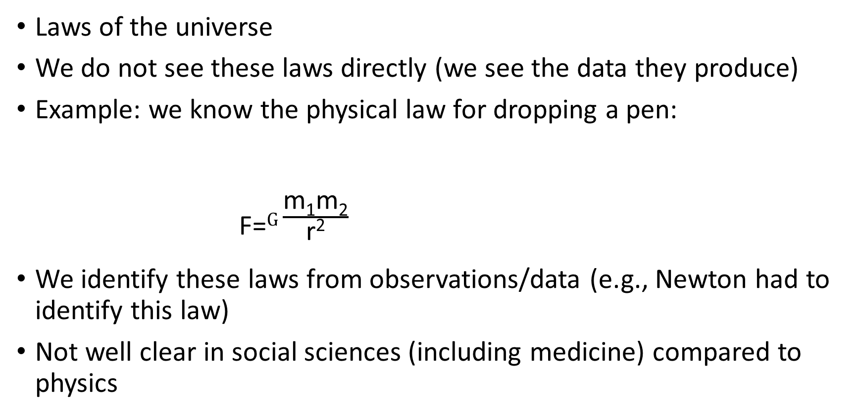
Data generating process
Example by Nick Huntington-Klein
Laws of the universe
We do not see these laws directly (we see the data they produce)
Example: we know the physical law for dropping a pen:
F=$G\frac{\text{m}\text{1}\text{m}\text{2}}{\text{r}\text{2}}$
We identify these laws from observations/data (e.g., Newton had to identify this law)
Not well clear in social sciences (including medicine) compared to physics
^{F: force}
^{G: gravitational constant}
^{M1: mass of object 1}
^{M2: mass of object 2}
r: distance between objects 1 and 2
The effect: An Introduction to Research Design and Causality by Nick Huntington-Klein https://theeffectbook.net/

Slide 24
Example of a data generating process in social sciences
Risk difference
0
Has effect
Risk difference
0
Has no effect
Notes:
Remember lack of an arrow is a very strong assumption (alcohol does not change lung cancer for anybody in the study)

Slide 25
Confounding bias

Slide 26

Confounding bias
Risk difference=0.3
Risk difference=0.3
Can we expect periodontitis and oral cancer to be associated?
Notes:
Remember lack of an arrow is a very strong assumption (alcohol does not change lung cancer for anybody in the study)

Slide 27
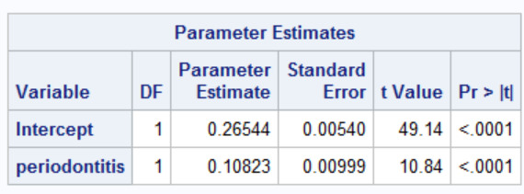
Confounding bias
data one;
do i=1 to 10000;
smoking=ranbin(-1,1,0.3);
periodontitis=ranbin(-1,1,0.2+0.3*smoking);
oral_cancer=ranbin(-1,1,0.2+0.3*smoking);
output;
end;
drop i;
run;
Risk difference=0.3
Risk difference=0.3
Can we expect periodontitis and oral cancer to be associated?
Risk difference=0.11
Is this causal or non-causal?
How much bias is here?
True causal effect 0
Effect estimated from data 0.11
Notes:
Remember lack of an arrow is a very strong assumption (alcohol does not change lung cancer for anybody in the study)

Slide 28
Confounding bias
Risk difference=0.3
Risk difference=0.3
Risk difference=0.2
Can we expect periodontitis and oral cancer to be associated?
Notes:
Remember lack of an arrow is a very strong assumption (alcohol does not change lung cancer for anybody in the study)

Slide 29
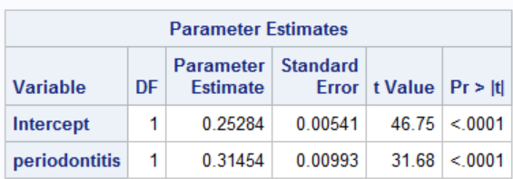
Confounding bias
data one;
do i=1 to 10000;
smoking=ranbin(-1,1,0.3);
periodontitis=ranbin(-1,1,0.2+0.3*smoking);
oral_cancer=ranbin(1,1,0.2+0.3*smoking+0.2*periodontitis);
output;
end;
drop i;
run;
Risk difference=0.3
Risk difference=0.3
Risk difference=0.2
Can we expect periodontitis and oral cancer to be associated?
Risk difference=0.31
Is 0.31 RD causal or non-causal?
How much bias is here?
True causal effect 0.2
Effect estimated form data 0.31
Notes:
Remember lack of an arrow is a very strong assumption (alcohol does not change lung cancer for anybody in the study)

Slide 30
Confounding bias
Mixing of effects
Non causal pathway through smoking
Risk difference=0.3
Risk difference=0.3
Risk difference=0.2
Causal pathway
Does periodontitis cause oral cancer? or that smoking causes oral cancer and it happens to be that smokers tend to have periodontitis

Slide 31
What do we do here?
Account for smoking by
Conditioning on smoking
Adjusting for smoking

Slide 32
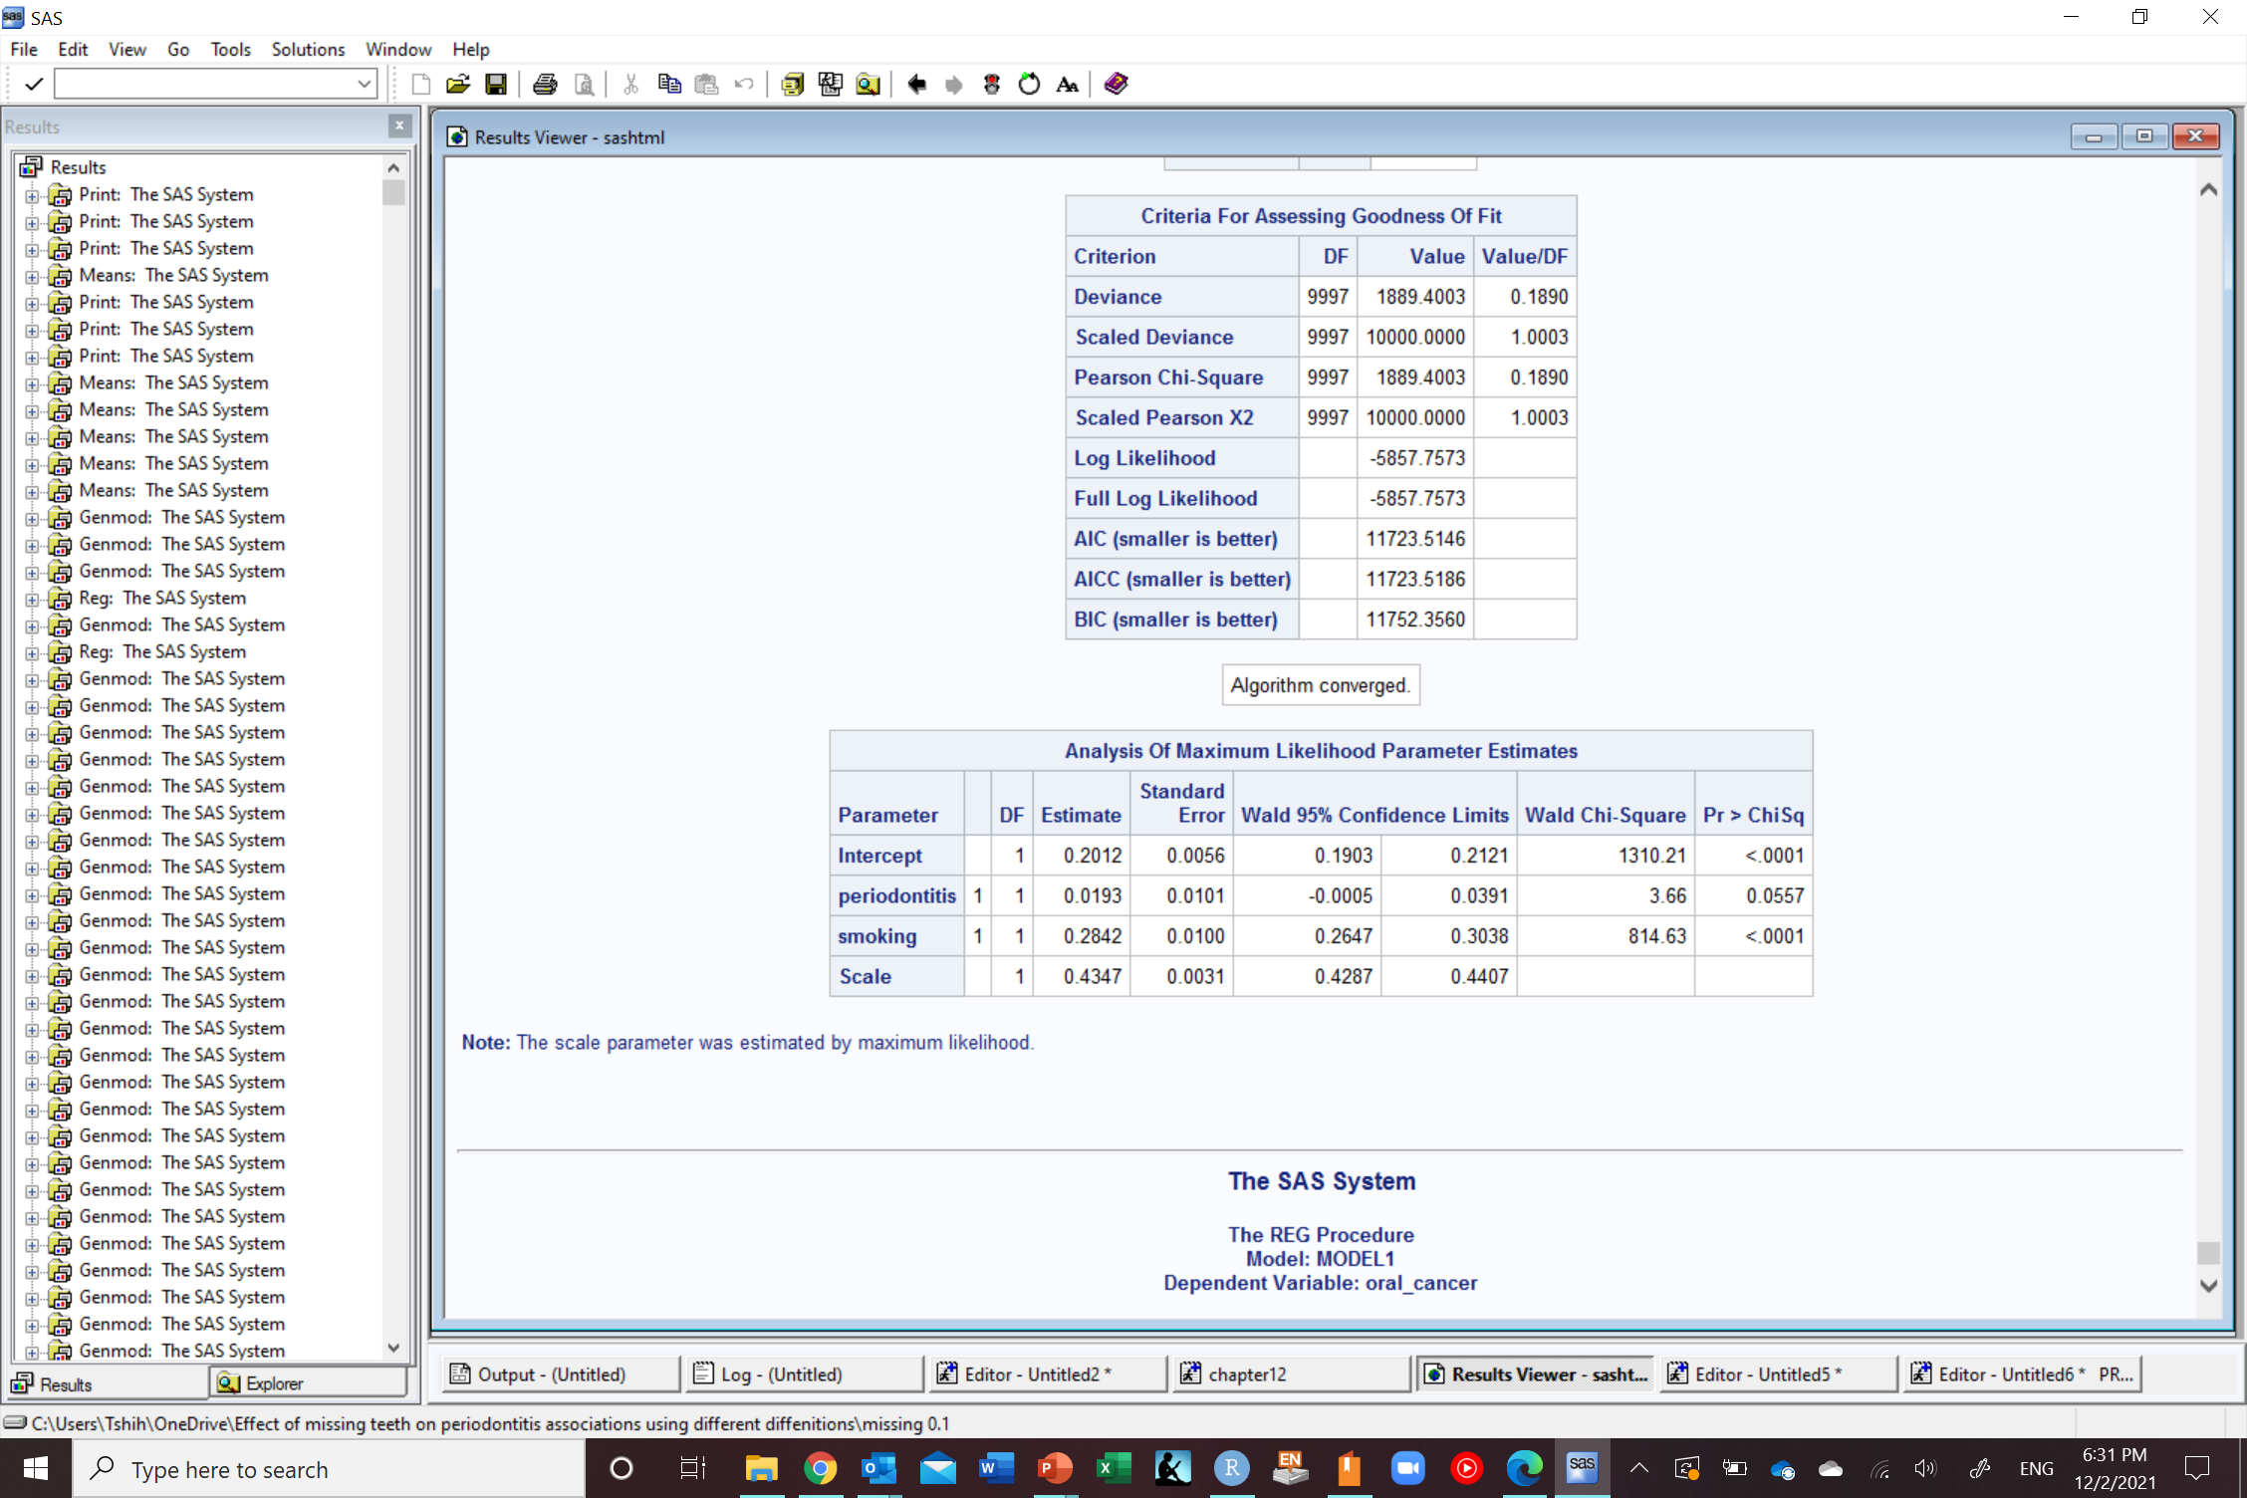
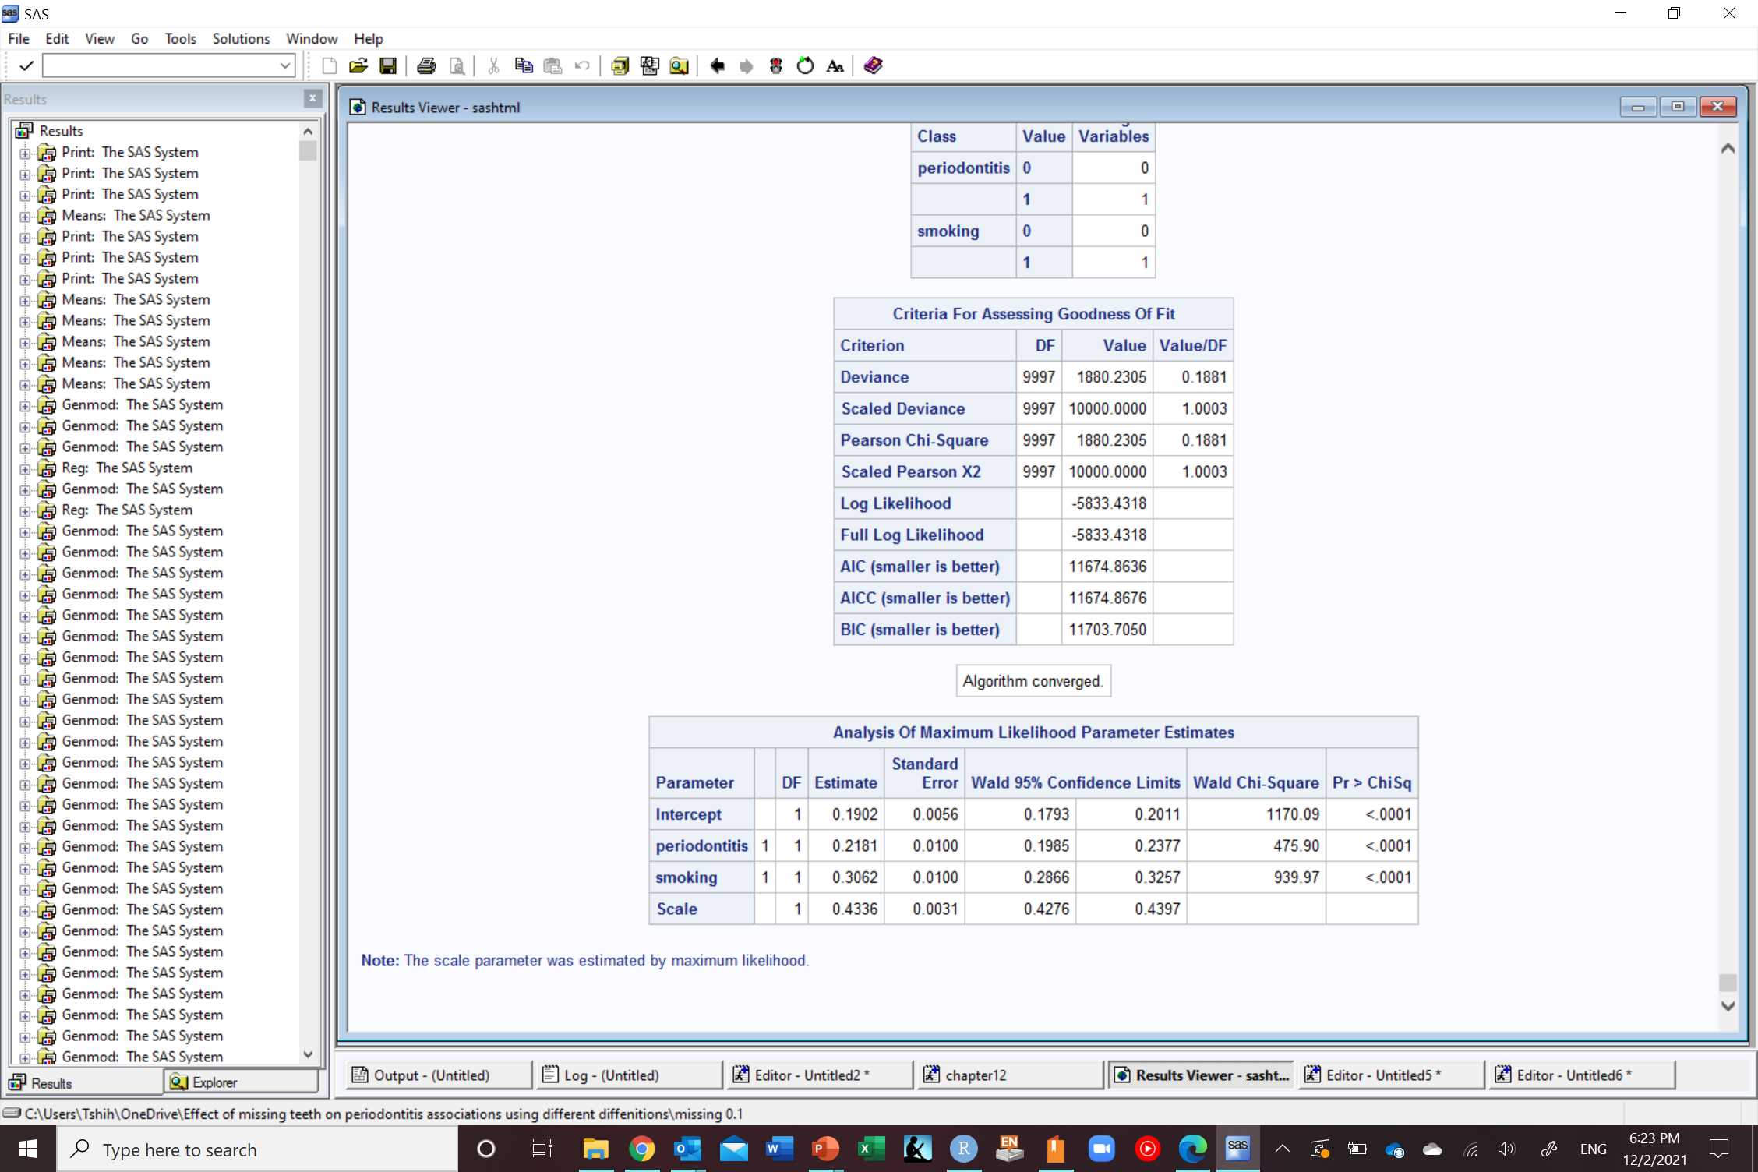
Confounding bias
Risk difference=0.3
Risk difference=0.3
Risk difference=0.3
Risk difference=0.3
Risk difference=0.2
Was 0.11 before accounting for smoking
Was 0.31 before accounting for smoking
Notes:
Remember lack of an arrow is a very strong assumption (alcohol does not change lung cancer for anybody in the study)

Slide 33
Confounding bias
What we mean by
“correlation is not causation”
”association is not causation”
Does not occur in RCT
Guarantee balance of covariates on average due to random assignment of exposure
Treatment assignment is random
Treatment assignment
Causes of outcome
Exposure
Outcome

Slide 34
Confounding bias
Occurs in observational studies
Do not guarantee balance of covariates
Treatment assignment is not random (choice/circumstance) which also increase risk of outcome
Causes of exposure and outcome
Exposure
Outcome

Slide 35
Examples of confounding in observational studies
Occupational factors
Healthy worker bias
Clinical decisions (confounding by indication)
Lifestyle
Smoking
Genetic factors
Genes/SNP
Social factors
Income
Environmental exposures
Pollutants
Hernán MA, Robins JM (2020). Causal Inference: What If. Boca Raton: Chapman & Hall/CRC.

Slide 36
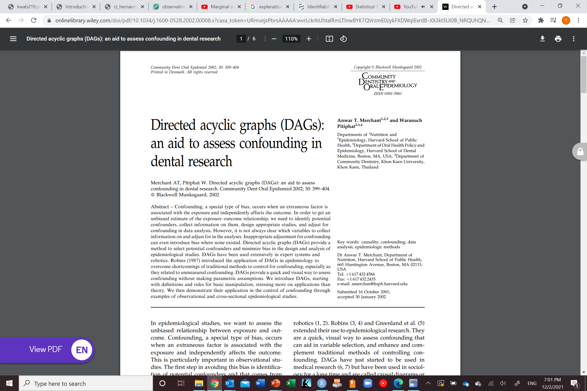
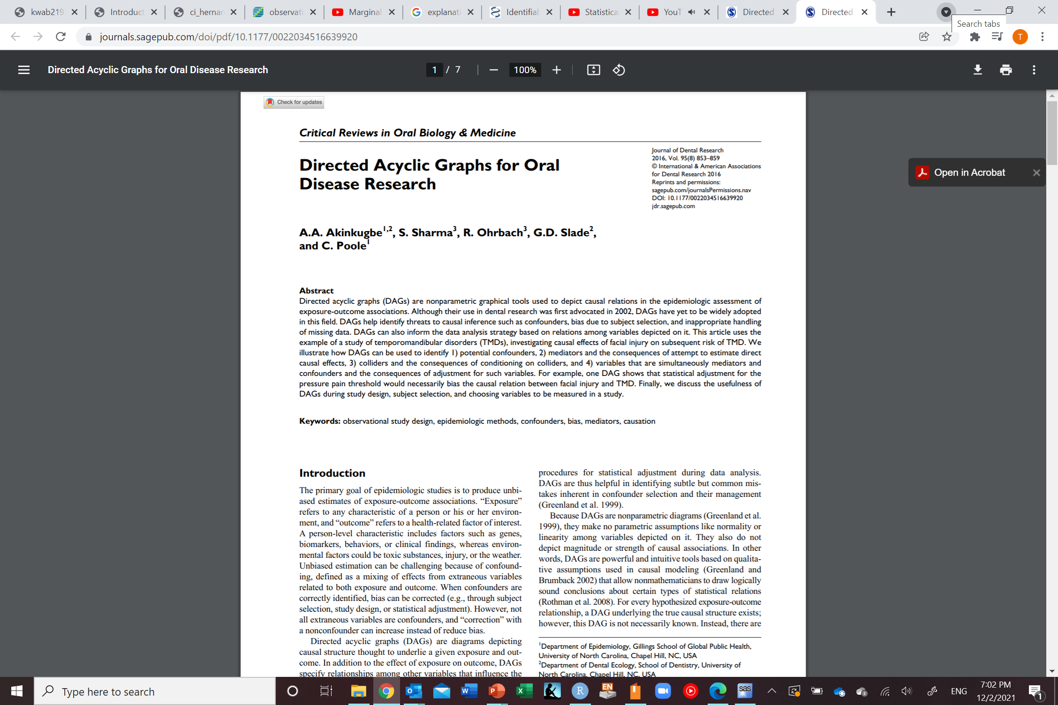
Confounding bias
How do we achieve balance of covariates in observational studies?
Ideally
Draw a DAG based on prior knowledge in collaboration with experts in the field
Identify the minimally sufficient set of variables to achieve balance of covariates
DO NOT SELECT VARIABLES BASED ON DATA
Not ideal
Based on what previous studies identified

Slide 37
Methods to handle confounding bias
During design
During analysis
Randomization
Restriction
Matching
Stratification
Regression
Matching
Propensity scores
Generalized methods (g-methods)
Standardization and parametric g-formula
Inverse probability weighting and marginal structural models
G-estimation
Doubly robust estimators/Targeted maximum likelihood estimates (TMLE): can include machine learning
Quasi-experimental
Instrumental variables
Regression discontinuity design
Difference in difference
Interrupted time series
Mendelian randomization

Slide 38


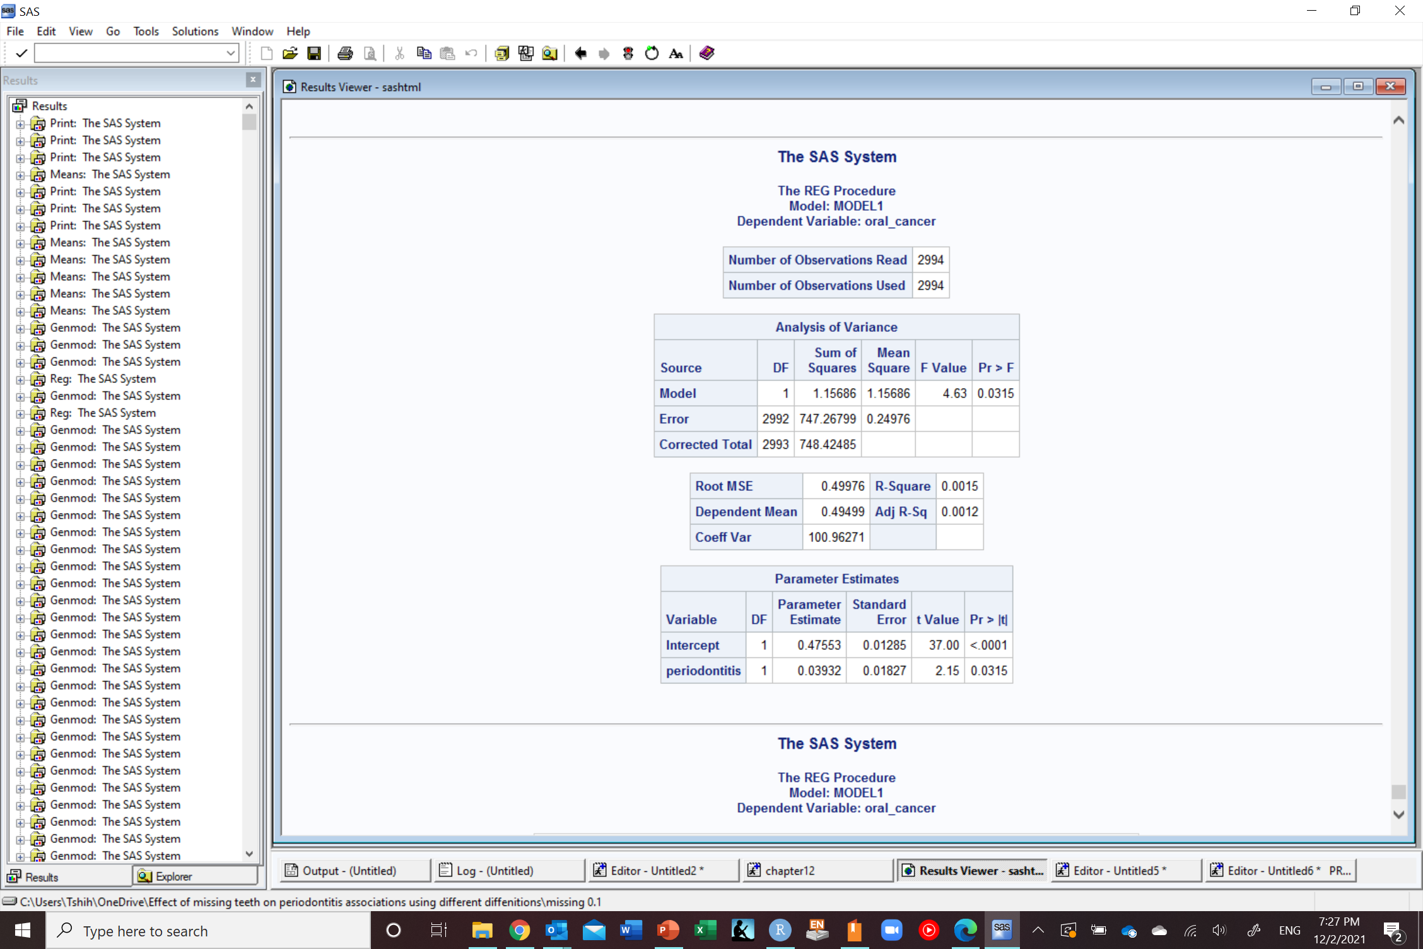

Stratification
Risk difference=0.3
Risk difference=0.3
Stratum-specific estimate

Slide 39
Restriction
Risk difference=0.3
Risk difference=0.3
Stratum-specific estimate

Slide 40
Restriction
Risk difference=0.3
Risk difference=0.3
Stratum-specific estimate

Slide 41
Regression
Risk difference=0.3
Risk difference=0.3
Was 0.11 before accounting for smoking
Notes:
Remember lack of an arrow is a very strong assumption (alcohol does not change lung cancer for anybody in the study)

Slide 42
Statistical tests
Special cases of regression
McElreath R. Statistical rethinking: A Bayesian course with examples in R and Stan. CRC press; 2020 Mar 13.

Slide 43
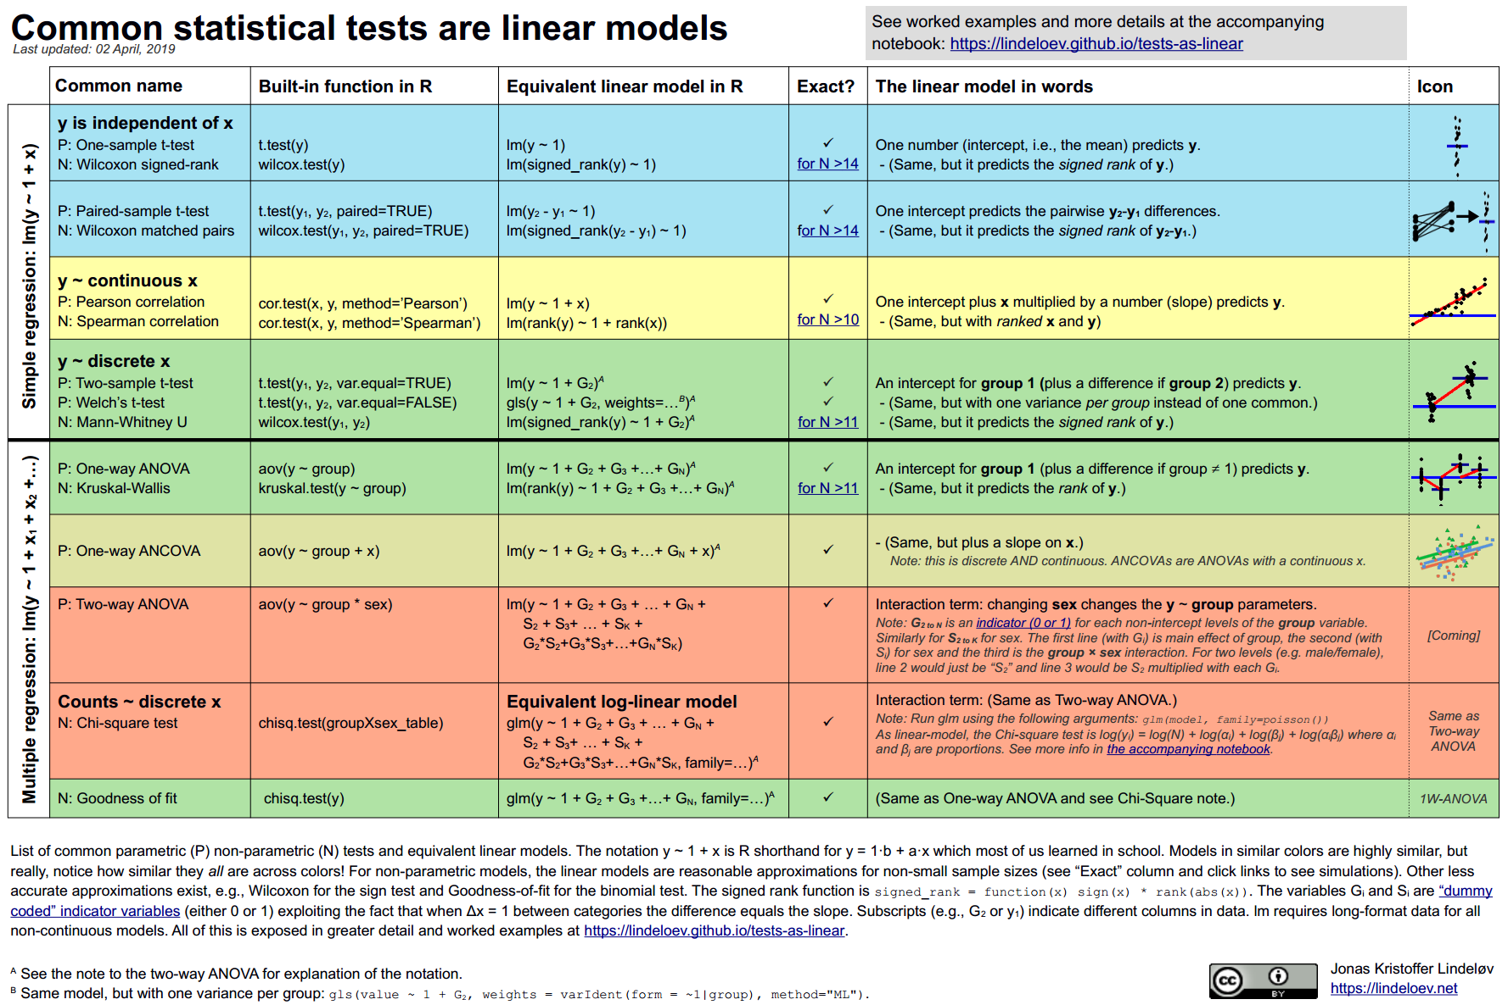

Slide 44
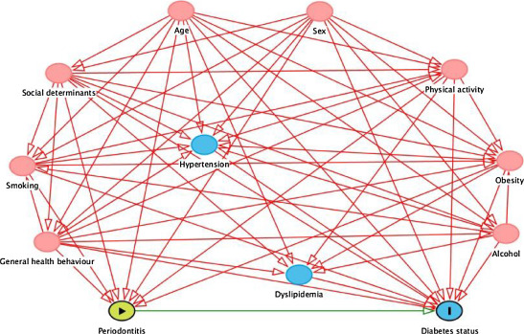
Confounding adjustment
Hypothetical examples
To show the concept
In reality
Need to adjust for multiple variables
to eliminate confounding
Kebede TG, Pink C, Rathmann W, Kowall B, Völzke H, Petersmann A, Meisel P, Dietrich T, Kocher T, Holtfreter B. Does periodontitis affect diabetes incidence and haemoglobin A1c change? An 11-year follow-up study. Diabetes & metabolism. 2018 Jun 1;44(3):243-9.

Slide 45
Risk difference=0.3
What are the reasons for this association between periodontitis and oral cancer in our study?
1
Random error
2
Sharing a common cause (confounding)
3
Conditioning on a common effect (selection bias)
Systematic errors
4
Measurement error (measurement bias)
5
Oral cancer caused periodontitis (reverse causation)
6
True (causal)

Slide 46
Selection bias

Slide 47
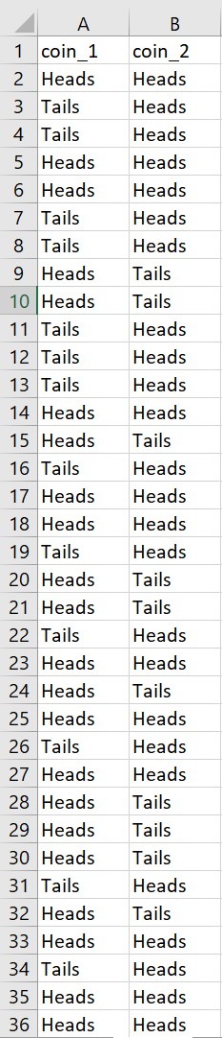
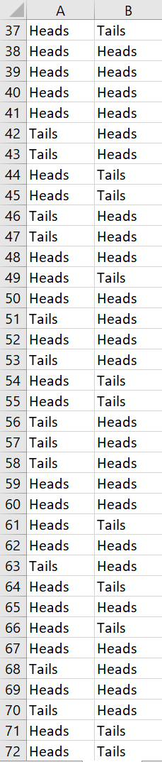
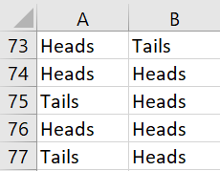
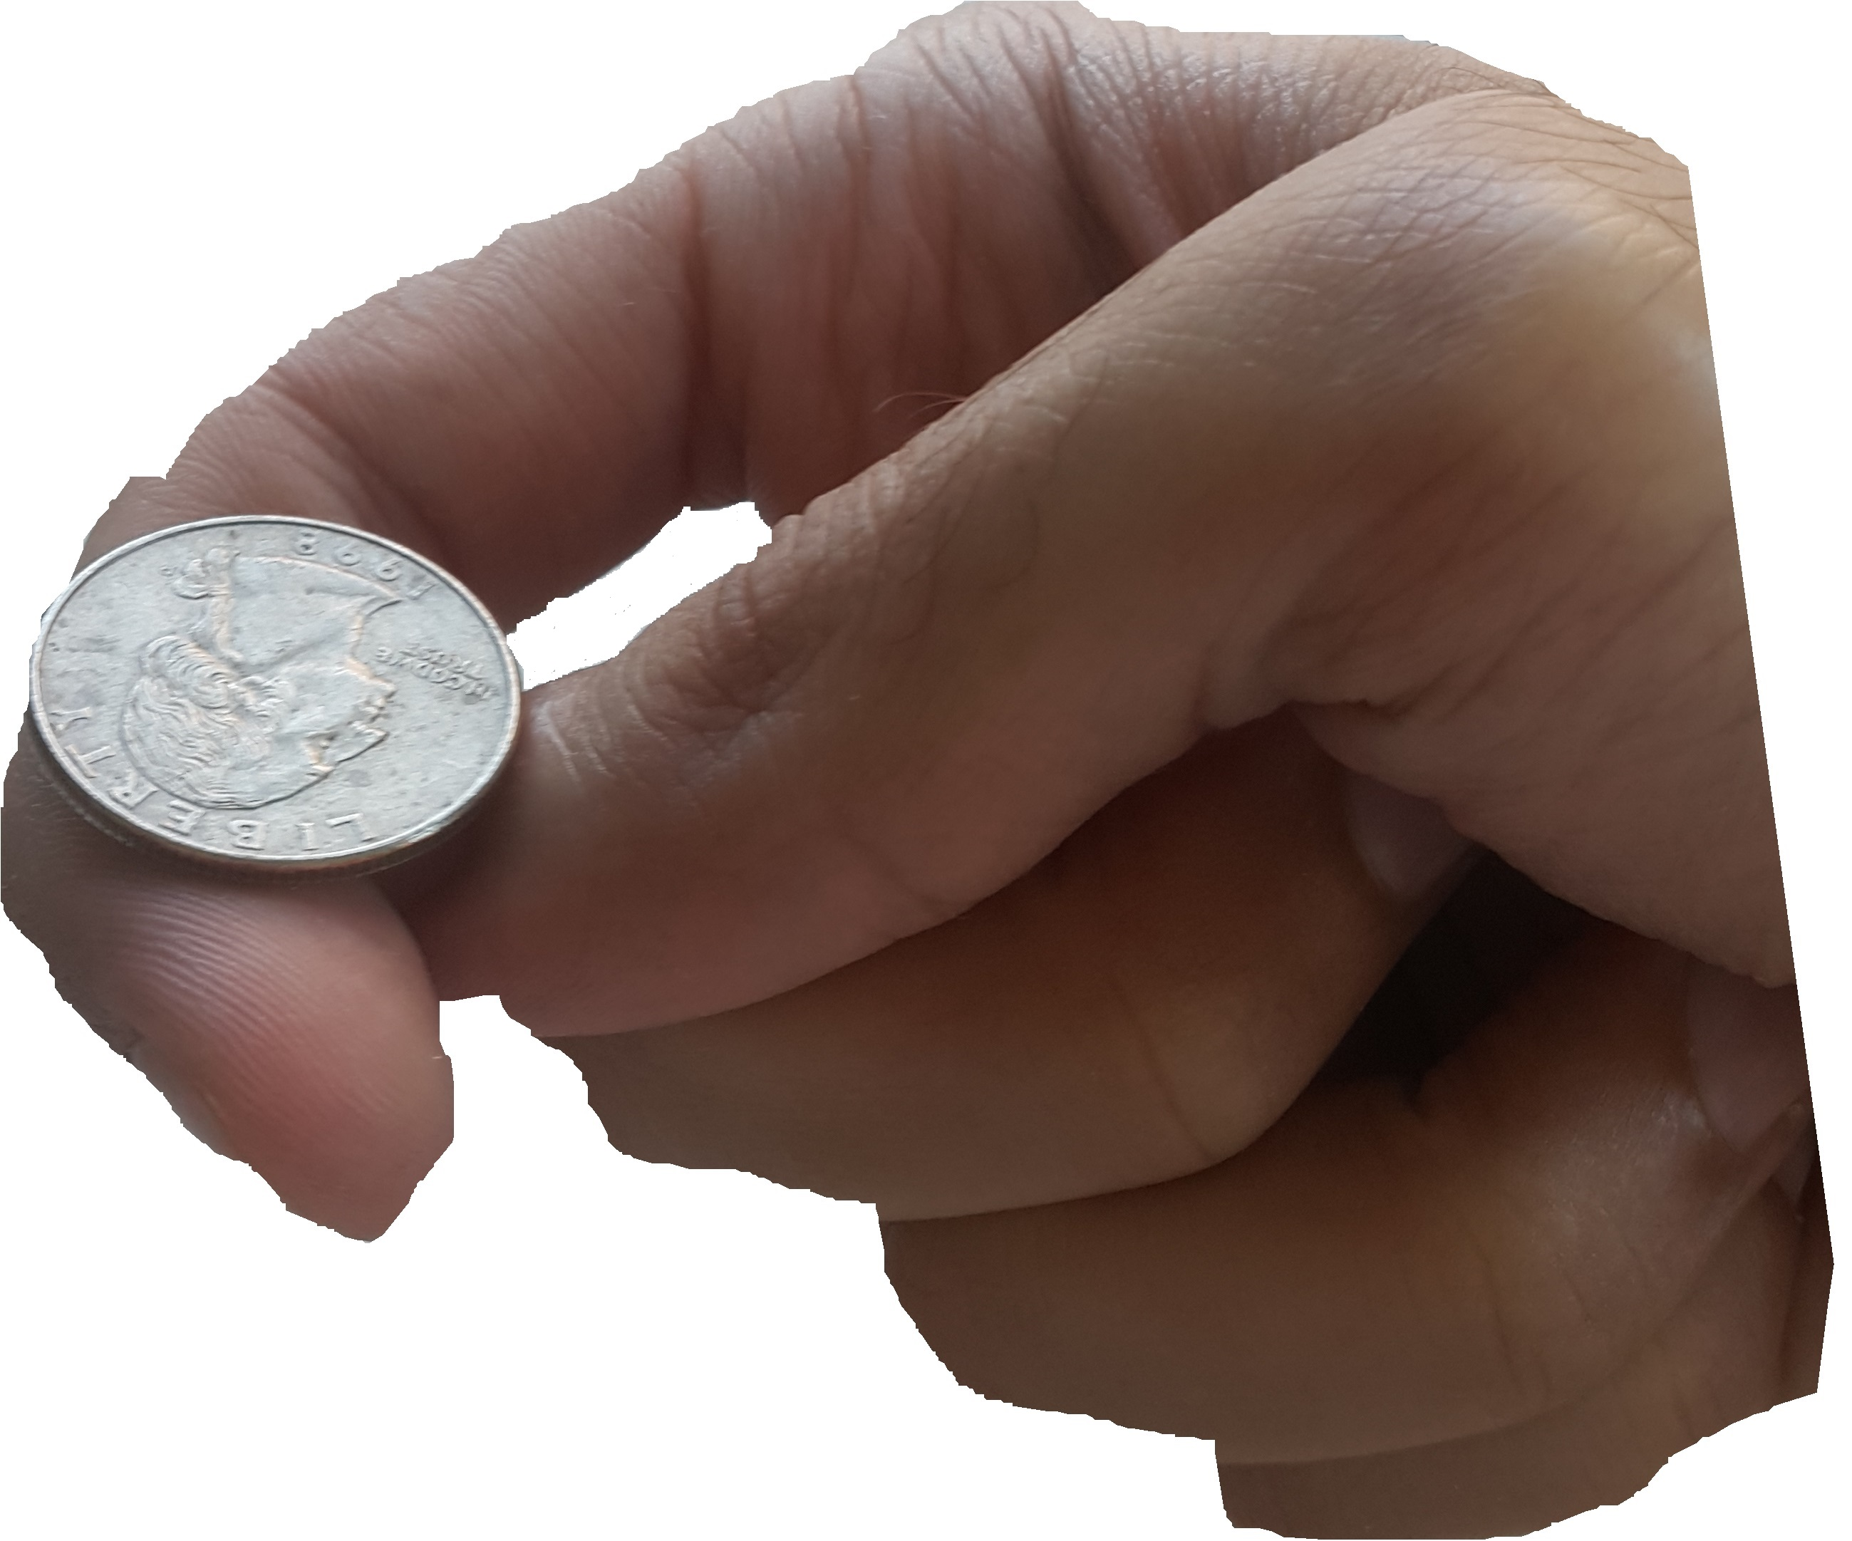
Selection bias
Example by Judea Pearl
Two independent coin tosses
100 times
Correlation is 0.02
Select trial if either coin 1 was heads or coin 2 was heads
Correlation is -0.47
Pearl J, Mackenzie D. The book of why: the new science of cause and effect. Basic books; 2018 May 15.

Slide 48

Selection bias
Coin 1 is H
Coin 2 is H
Coin 1 is H
Coin 2 is H
Selection of trial
Selection of trial
No causal pathway
Non-causal pathway through conditioning on selection of trial (only trials where coin 1 or coin 2 was heads)

Slide 49
Selection bias
Collider stratification bias
Selecting on a common effect
Coin 1 is H
Coin 2 is H
Selection of trial

Slide 50



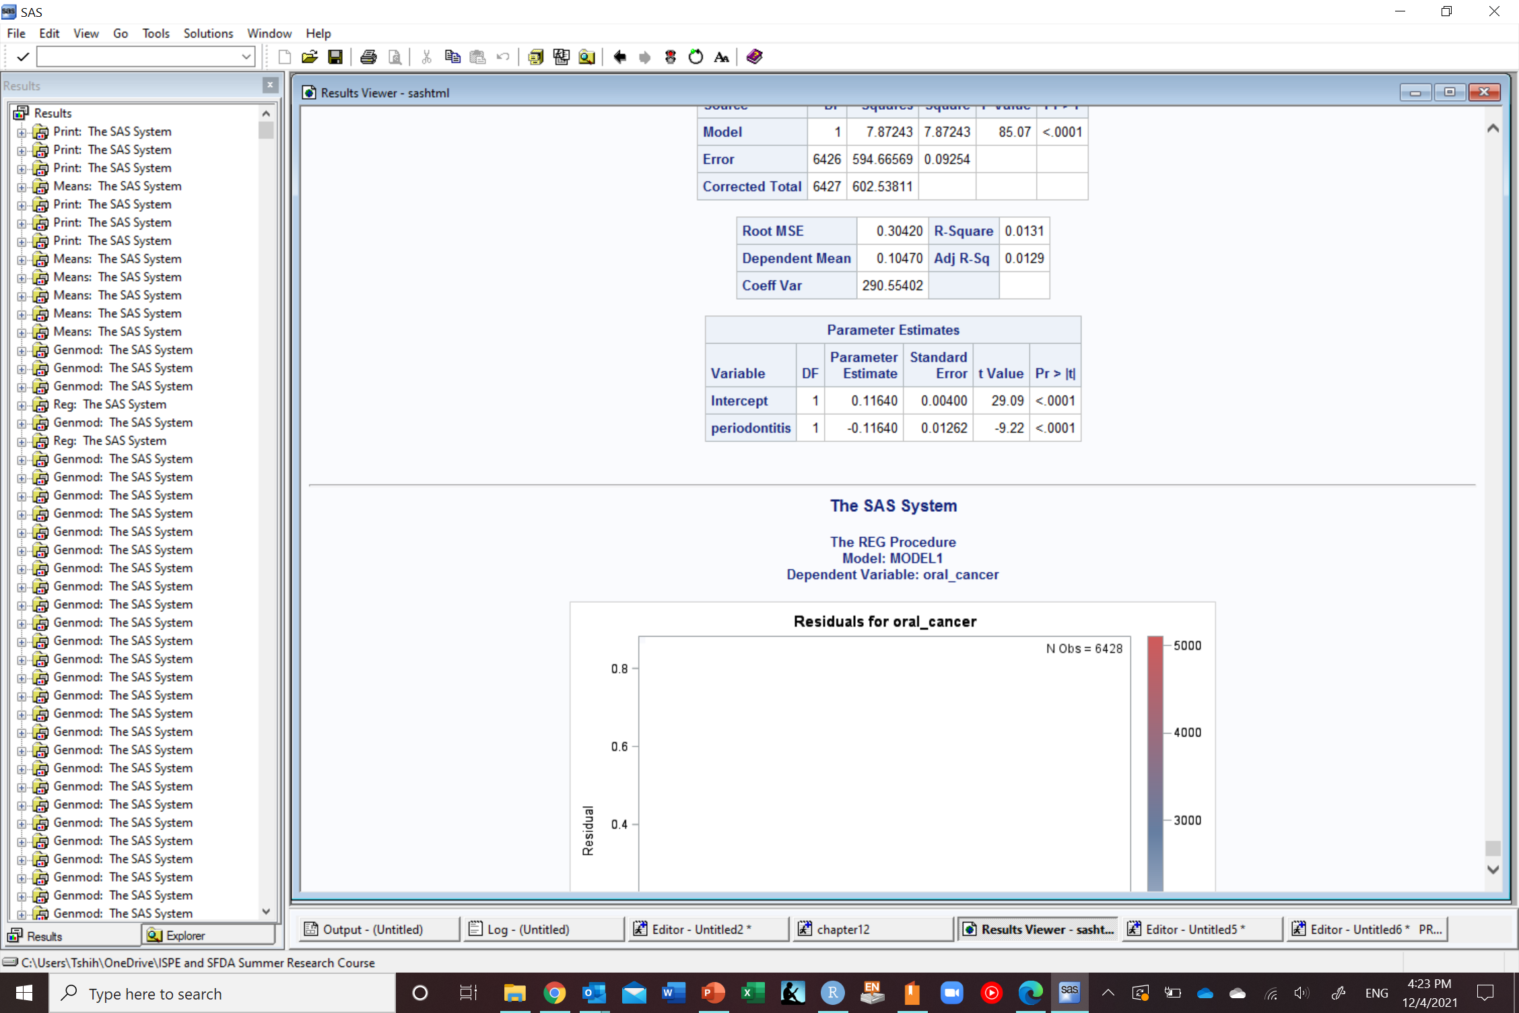
Selection bias
Only among those who agreed to participate
Notes:
Remember lack of an arrow is a very strong assumption (alcohol does not change lung cancer for anybody in the study)

Slide 51
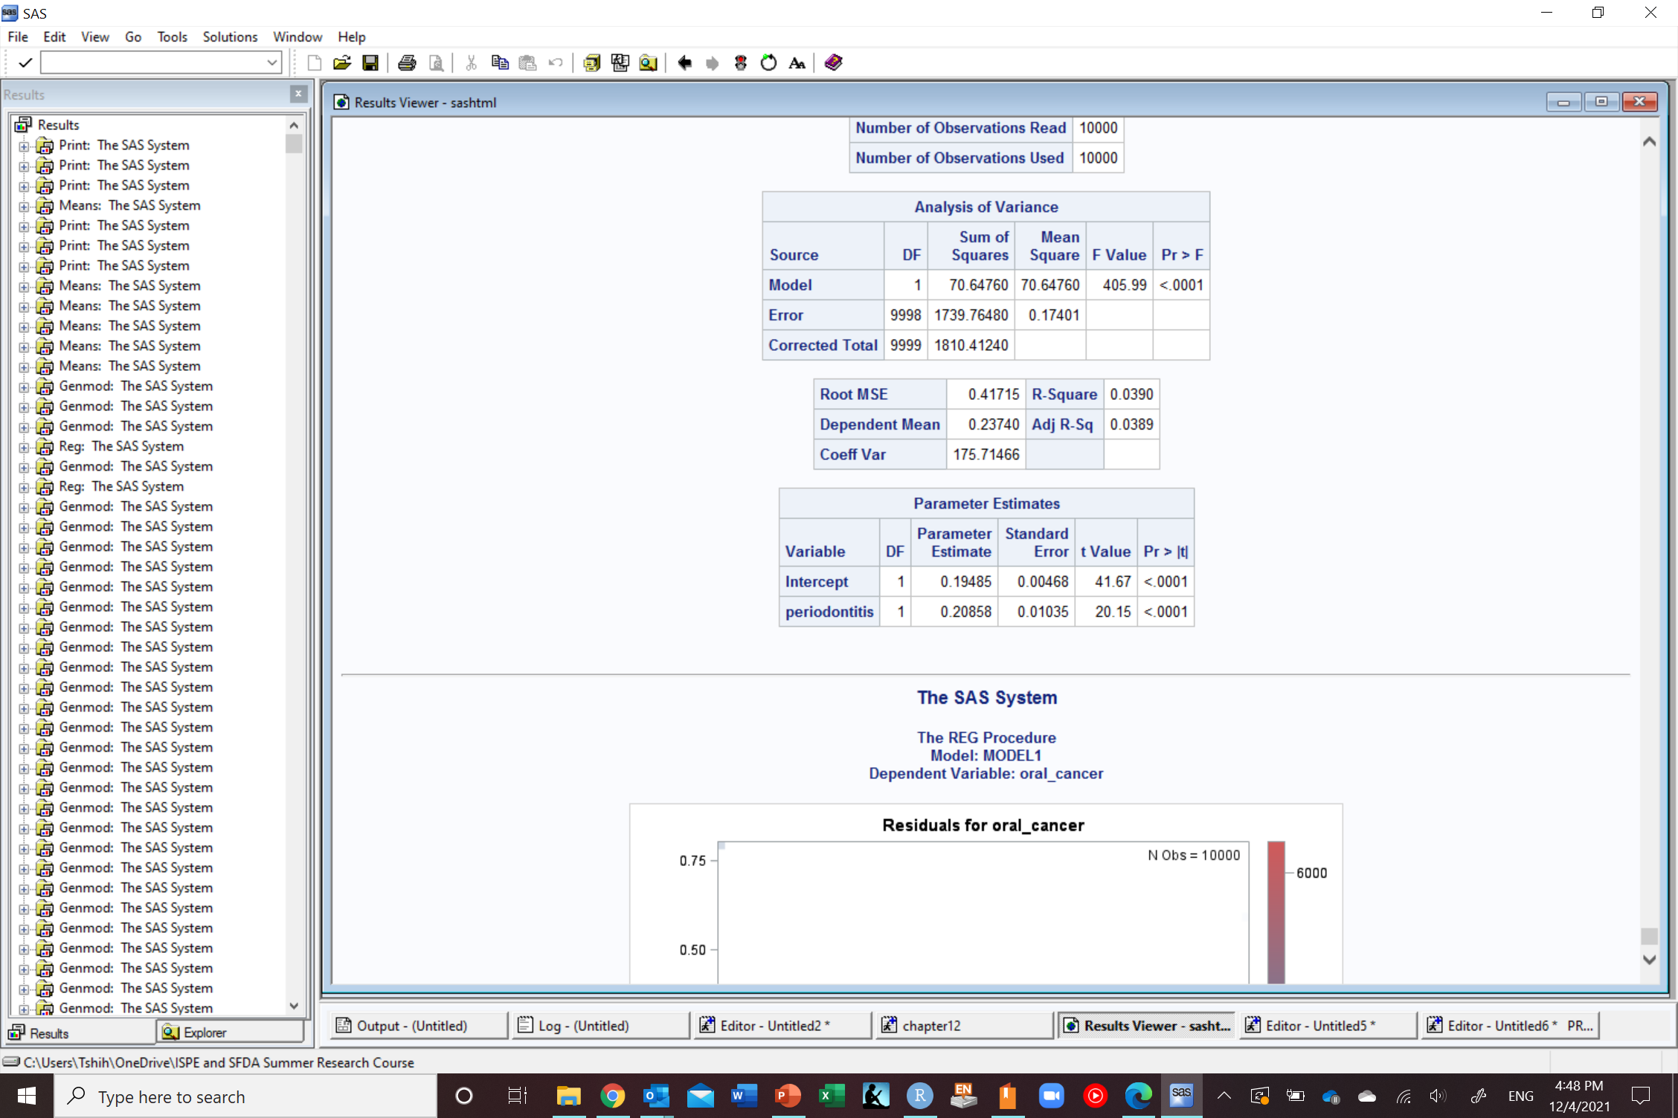
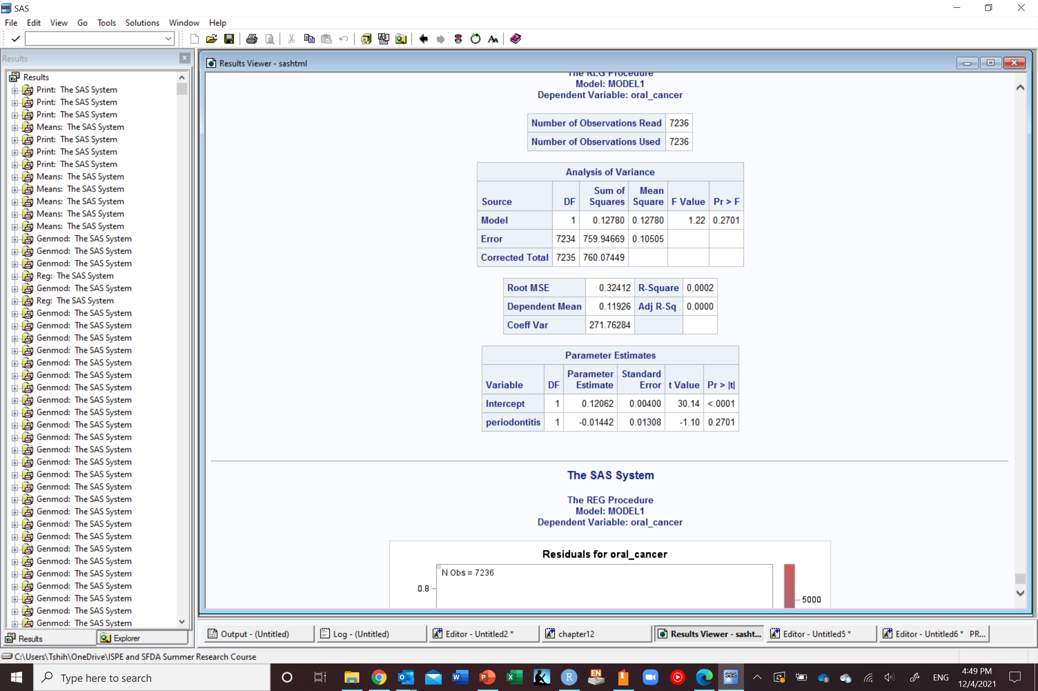
Selection bias
Risk difference=0.2
Risk difference=0.2
Only among those who agreed to participate
Notes:
Remember lack of an arrow is a very strong assumption (alcohol does not change lung cancer for anybody in the study)

Slide 52
Examples of selection bias
Baseline participation
Self-selection (volunteer)
Differential loss to follow up
Missing data
Healthy worker
Berksonian

Slide 53
Risk difference=0.3
What are the reasons for this association between periodontitis and oral cancer in our study?
1
Random error
2
Sharing a common cause (confounding)
3
Conditioning on a common effect (selection bias)
Systematic errors
4
Measurement error (measurement bias)
5
Oral cancer caused periodontitis (reverse causation)
6
True (causal)

Slide 54
Measurement bias

Slide 55

Example for oral cancer measurement in a study
 | Oral cancer status positive in actual life | Oral cancer status negative in actual life | Total
Measured as positive in study | 500 | 0 | 500
Measured as negative in study | 0 | 500 | 500
Total | 500 | 500 | 1,000
100%
Sensitivity=500/500=1
100%
Specificity=500/500=1
Validity of a measurement is the extent to which people are correctly classified
(agreement between actual disease status and measurement in study)

Slide 56
Example for oral cancer measurement in a study
 | Oral cancer status positive in actual life | Oral cancer status negative in actual life | Total
Measured as positive in study | 400 | 50 | 500
Measured as negative in study | 100 | 450 | 500
Total | 500 | 500 | 1,000
True positive
80%
False positive
10%
Sensitivity=400/500=0.8
False negative
20%
True negative
90%
Specificity=450/500=0.9

Slide 57
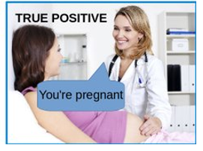
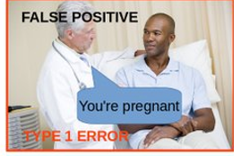
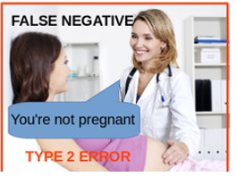
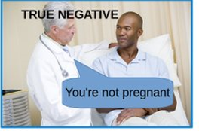
Pregnant
Not Pregnant
Pregnancy test +
Pregnancy test -
https://twitter.com/freakonometrics/status/779060142239260672 with some modifications

Slide 58
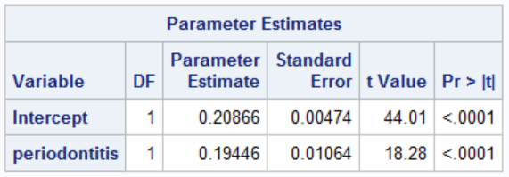
Measurement bias
Risk difference=0.2

Slide 59
Exposure misclassification Do you have periodontitis now?
Actual
In study
 | Perio + | Perio -
Oral cancer + | A | B
Oral cancer - | C | D
<100%
>0%
< 1 sensitivity
>0%
<100%
<100%
>0%
>0%
<100%
< 1 specificity

Slide 60

Exposure misclassification Do you have periodontitis now?
Risk difference=0.2
 | Perio + | Perio -
Oral cancer + | A | B
Oral cancer - | C | D
Actual
In study
80%
20%
10%
90%
0.8 sensitivity
80%
20%
10%
90%
0.9 specificity

Slide 61
Measurement bias Sources
Conceptual level (construct validity)
Smoking
Absence or presence
Presence and intensity
Presence, intensity, and duration
Incomplete assessment of variable information
No uniform understanding of what constitutes the variable
Data collection
Self-report (either in survey or medical record)
Misdiagnosed conditions in medical records
Inaccurate information in medical records
Data management and handling
Transfer data from original source to computer
Data transformations

Slide 62
Measurement bias
Synonymous with information bias
Misclassification bias for categorical variables
Can occur in
Exposure
Outcome
Confounder
Can occur together
Independent
Dependent
Mechanism
Non-differential
Differential

Slide 63



Exposure misclassification Do you have periodontitis now?
Actual
In study
Actual
In study
Non-differential
Differential

Slide 64
Risk difference=0.3
What are the reasons for this association between periodontitis and oral cancer in our study?
1
Random error
2
Sharing a common cause (confounding)
3
Conditioning on a common effect (selection bias)
Systematic errors
4
Measurement error (measurement bias)
5
Oral cancer caused periodontitis (reverse causation)
6
True (causal)

Slide 65
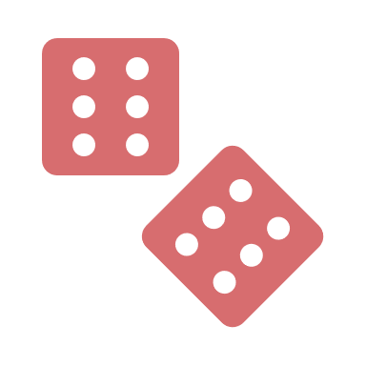
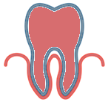
Potential explanations of an association
Systematic errors
1
2
3
4
5
6
Random error
Sharing a common cause
(confounding bias)
Conditioning on a common effect
(selection bias)
Measurement error
(measurement bias)
Reverse causation
Causal

Slide 66
Systematic errors in RCTs vs observational studies
Randomization protects against baseline confounding
Randomization does not protect against
Selection bias if selection occurs after randomization
Measurement bias

Slide 67
Descriptive studies
Selection bias
Measurement bias
Misclassification bias (categorical)
Information bias
Hernán MA, Hsu J, Healy B. A second chance to get causal inference right: a classification of data science tasks. Chance. 2019 Jan 2;32(1):42-9.

Slide 68


Descriptive studies
Outcome
Selection bias
Participation
Prevalence of disease in population
12/40=30%
Prevalence of disease in sample
2/16=12.5%
Convenience sample

Slide 69



Internet access
77% out of total population in 2017 (Ministry of communications and Information Technology)
94% out of study participants aged 12-65 years in 2016 (Communications and Information Technology Commission)
96% in 2019
93% in another source in 2020
Reasons for not using internet among study participants aged 12-65 years who did not use internet in past 6 months in 2016 (Communications and Information Technology Commission)
Do not know how to use it 51%
Do not know uses of internet 17%
Family does not allow its use 17%
Do not know internet 15%
Do not know how to subscribe 12%
Not available 10%
Cannot afford it 9%
If you would like to know the knowledge of the Saudi population and you distribute a questionnaire online
What do you think would happen here?
https://www.citc.gov.sa/ar/reportsandstudies/studies/Documents/PublicIndividualReport2016V5_Ar.pdf
https://www.mcit.gov.sa/ar/open-data
https://data.worldbank.org/indicator/IT.CEL.SETS?locations=SA
https://datareportal.com/reports/digital-2020-saudi-arabia

Slide 70

Descriptive studies
Measurement bias
Misclassification bias (categorical)
Information bias
Measuring weight when the pin is placed at 5 kilos instead of 0
What do you think would happen here?

Slide 71
Predictive studies
Selection bias
Measurement bias
Misclassification bias (categorical)
Information bias
Hernán MA, Hsu J, Healy B. A second chance to get causal inference right: a classification of data science tasks. Chance. 2019 Jan 2;32(1):42-9.

Slide 72
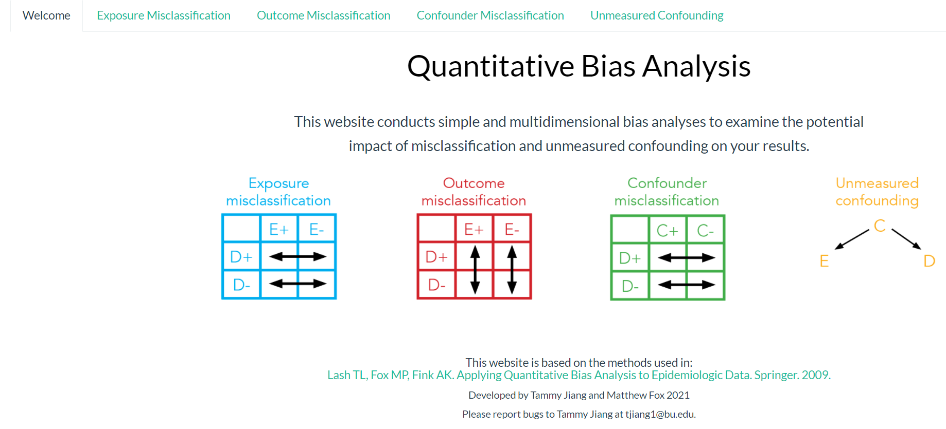
Bias analysis
Unmeasured confounding
Selection bias
Measurement bias
Multidimensional bias analysis
Probabilistic bias analysis
https://sites.google.com/site/biasanalysis/
https://jiangtammy.shinyapps.io/quantitative_bias_analysis/

Slide 73
The goal of science is to try and show that our results are false
All studies are based on assumptions and it is our duty to see if these assumptions hold

Slide 74
Any Questions?
shihaybt@ksau-hs.edu.sa

